Slide 1
Become member: www.sra.scot
Friday’s question - Supermarket or convenience store?

Slide 2
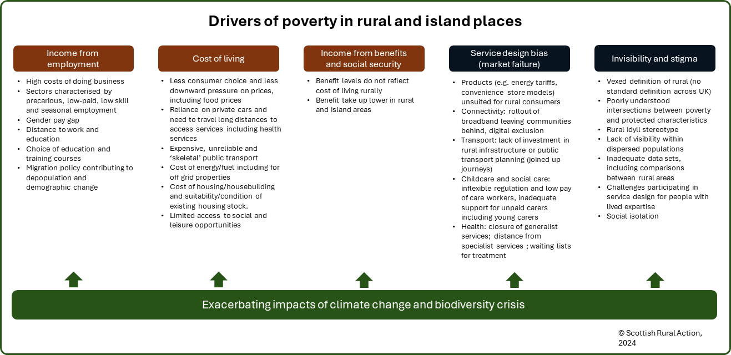
Become member: www.sra.scot

Slide 3
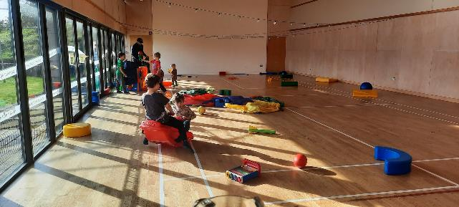
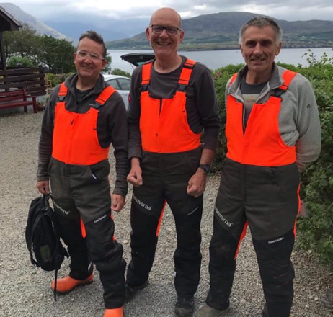
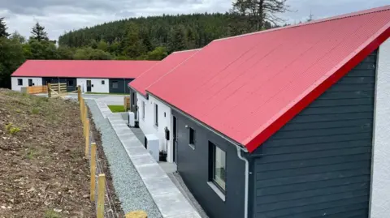
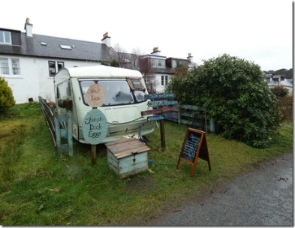
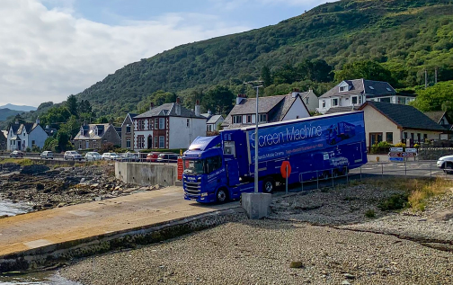
A positive vision Community level building blocks to tackle poverty in rural and island places
Community Centre and volunteer run social activities
Woodland/land management
Community transport
Community led local development (place planning)
Flexible and plural work practices
Mobile services
Local food systems
Local energy systems

Slide 4
1. Rural policy must be place based, built on what rural and island communities themselves are already doing to tackle challenges and grasp opportunities.

Slide 5
2. Rural policy must identify what action is required by government, including, where possible, through market regulation, to strengthen and underpin community level building blocks.

Slide 6
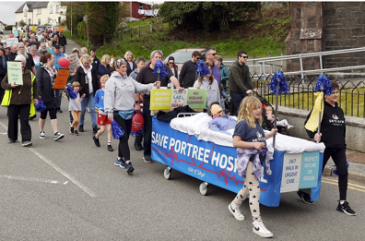
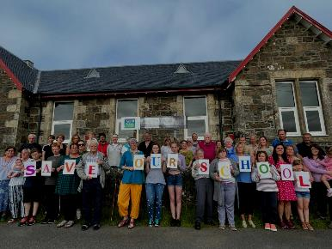
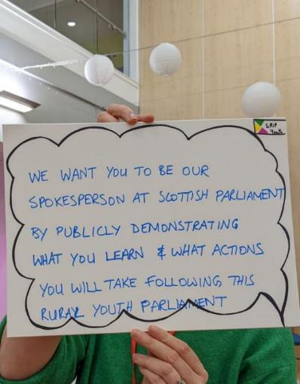
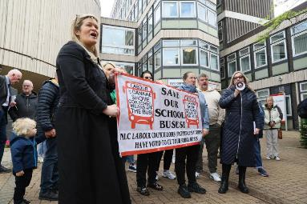
3. Rural policy must seek to address the institutional barriers to rural and island development:
Policy siloes, including across government tiers
Perspectives of ‘rural’ including poverty in rural and island places
Growth focus
Focus on communities, as opposed to individual consumers or service recipients

