Slide 1
Rural Delivery Plan
Information Sharing for Stakeholders

Slide 2
Background and Scope of Rural Delivery Plan
The Scottish Government committed to publish a plan by the end of this parliament, because we recognise that:
Scotland’s rural economy is vitally important to all of Scotland.
Rural communities face significant and unique challenges compared to other parts of Scotland
The Plan addresses the issues you have told us are relevant to rural Scotland and sets out a vision and nine high level Strategic Objectives:
Agriculture and Marine
Economy and Digital
Population and Skills
Social Justice
Housing
Health and Social Care
Environment and Climate Change
Transport
Culture
The Plan covers mainland rural Scotland, with the National Islands Plan addressing the needs of island communities separately.

Slide 3
Approach of The Rural Delivery Plan
Impact
Collating and communicating investment
Improved policy understanding and flexibility
Tracking data and results over time

Slide 4
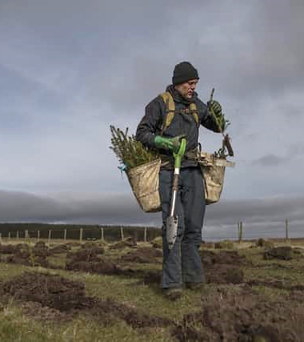
The Plan sets out a picture for rural Scotland
The Plan provides a comprehensive picture of how the Scottish Government is delivering for rural communities and a clear vision for rural Scotland’s future
We are developing a new approach to regular monitoring of the key metrics across rural Scotland to help us respond and adapt our focus to where it is most needed
We will roll out a Rural Lens Toolkit to ensure rural needs are considered in all policy making in Scottish Government

Slide 5
How we are developing the Plan
Mainland Rural Delivery Plan
Ministerial Commitment and ongoing input to the Plan
Working across Scottish Government to understand range of rural issues
Developing a toolkit to support rural focussed policy making
Working with our data analysts to identify robust data sets
Reviewing previous public consultation responses
Gathering feedback from our Stakeholders including our rural Stakeholders

Slide 6
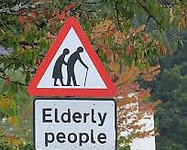
Focus on Rural Poverty – Key Scottish Government Strategies and Investments
The Just Transition Fund supporting skills interventions, innovation and emerging technologies, and empowering local communities.
The Addressing Depopulation Action Plan
The Scottish Land Commission
The Fair Work First conditionality
The Promise implementation plan for care experienced children, young people and their families.
School Age Childcare Delivery Framework (2023) to support the sustainability of essential school age childcare services within rural and island communities.
The Access to Childcare Fund
Early Adopter Communities projects around delivering local childcare to help eradicate poverty
The Rural and Island Housing Action Plan
The Rural and Islands Housing Fund & Rural Affordable Homes for Key Workers Fund
Discretionary housing payments investment of over £90m
Energy efficiency improvements for households in extreme fuel poverty in remote rural areas
Rural and Islands Workforce Recruitment Strategy (RIWRS) for Health and Social Care by the end of 2024
Getting It Right For Everyone pathfinders to enhance community care and treatment centres.

Slide 7
How we will monitor performance – Possible Key Performance Indicators
Working age employment rate (residence based)
Economic activity of population aged 16-64
Involuntary non-permanent work
Real living wage
How the household is managing financially
Relative poverty - Proportion (%) of people / children in each category who are in relative poverty
Early Child Development Statistics on children's development as assessed during the 13-15 month / 27-30 month and 4–5-year child reviews
Percentage of secondary school leavers by initial destination category and 6-fold Urban Rural classification, 2009-10 to 2022-23
Quality of care experience (Health and Social Care)
Healthy Life Expectancy (males / females)
Affordable Housing Supply Programme (AHSP) Completions by location for 2021-22
Affordable Housing Supply Programme (AHSP) Social And Affordable Completions by Local Authority 2007-2008 to 2023-2024
Proportion (%) of homes in fuel poverty
Level of extreme fuel poverty (2-fold / 6-fold)
Percentage of dwellings with urgent disrepair to critical elements
Average weekly household expenditure in Scotland on transport and vehicles (£)
How easy or difficult people find it to afford transport costs
Participation in any cultural activity

Slide 8
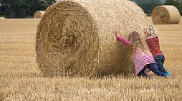
Poverty in Rural Areas –What the data tell us
The Positives
Rural Scotland is served by several high-quality colleges, higher educational institutions and universities financially supported through the Scottish Funding Council and Skills Development Scotland.
In 2021, 37% of Foundation Apprenticeships starts at SCQF L6 were in mainly rural Scotland
In 2022-23, 29% of all Modern Apprenticeship starts in Scotland were in mainly Rural areas
The Scottish Government has committed to strengthening approaches to regional skills planning
Natural Capital and empowering communities; rural areas overall contain 79% of community owned assets and around 99% of community owned land.
Life expectancy is higher in rural areas than in urban areas of Scotland
The Challenges
The living costs for households in many rural parts of Scotland can be as much as 15-30% higher than other parts of the UK (weekly food costs, transport, low energy efficiency rate dwelling)
Access to services and affordable housing
Risks for fuel poverty (dwellings not within gas grid; oil used as a primary heating fuel)
Much higher transport costs (weekly travel costs estimated to be up to 251% higher for pensioners living in remote rural areas on the mainland)
Agricultural and land reform causing changes to the rural workforce and traditional industries as part of a move to a climate resilient economy.
Aging population; growing proportion of the population in rural areas now aged over 65 years.
The ability to attract new talent and finding staff with adequate skills are risks to the businesses of the rural employers.
Challenges with rural childcare provision (changes in demand and recruitment of staff) and the costs of childcare.

Slide 9
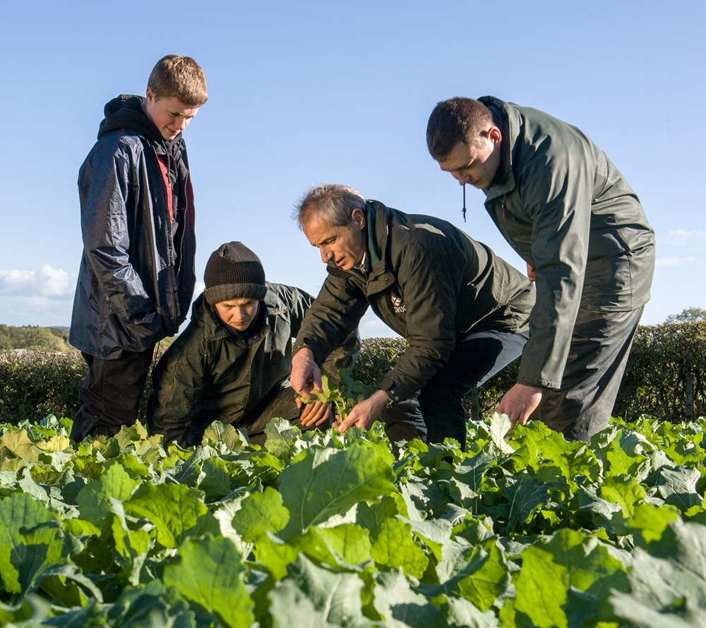
Publishing & Future Reporting
Rural Delivery Plan to be published during the lifetime of this parliament
Annual data refreshers
Regular publishing of Key Performance Indicators to support informed policy making, that delivers better outcomes for rural Scotland
Full review and refresh of the Plan
Ongoing engagement with rural stakeholders

Slide 10
Questions for us? Questions for you:
For any feedback or questions, please contact
RuralPolicyMailbox@gov.scot
Any Key Performance Indicators that you would like to suggest?
Any key events that we should regularly engage with?
Is there a particular approach to ongoing reporting that you would find valuable?​

