Slide 1
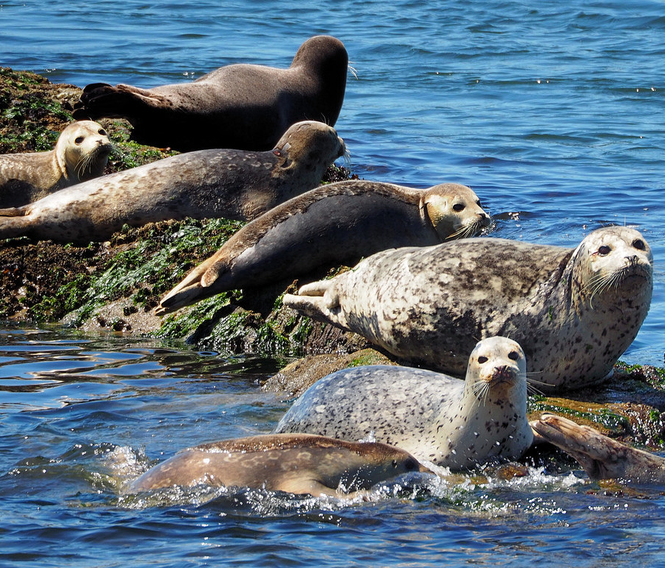
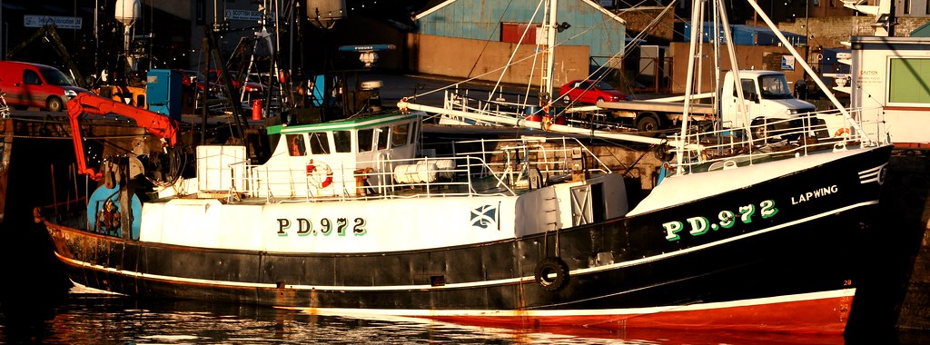
Aberdeenshire Local Voices
This Photo by Unknown Author is licensed under CC BY-SA
This Photo by Unknown Author is licensed under CC BY-NC-ND
This Photo by Unknown Author is licensed under CC BY-NC-ND

Slide 2
Local Voices – Partnership to decision making
Why engage?- Improve practice, policy and performance, true partnership with local people.
Who? – Anyone who lives or works in Aberdeenshire 11 years and over.
How? – Focus groups, online forum, 1-1 interviews, expert panels , Aberdeenshire Lived Experience Network (ALEN) and Youth Rights Committee.

Slide 3
Engagement & Participation
Lived Experience Forum – Solution focused , partners resource
Referrals from partners & individuals
1-1 chat around roles & responsibility
On line ,anonymous not facilitated
Youth Rights Committee – Rights based
Mostly face to face, use existing youth network, workshops and issue based.
Aberdeenshire Lived Experience Network
Partnership network which are commitment to positive engagement with clients & local people. On line & face to face.

Slide 4
Local Voices – Impact
Inform policy – Housing, NHS, Charges for activities,
Co-develop training – Trauma informed , Worried About Money workshop, stigma , Poverty & lived experience.
Allocate & securing funding – AVA, TP&I funds, Cash First funding
Deep dive - Fuel Poverty , transport, childcare
Deliver Local Voices Events – Challenge Poverty events, youth event, Employablity event

Slide 5
Contact detail
Agnese Carter
Poverty Engagement Worker
Tackling Poverty & Inequalities
Phone number: 01467 535835 mob: 07775507649
E-mail: Agnese.carter@aberdeenshire.gov.uk
https://www.facebook.com/agnese.carter.5/
Annette Johnston Tackling Poverty & Inequalities Tel: 01467539860
annette.johnston@aberdeenshire.gov.uk

