Slide 1
Values First!
Putting moral values at the heart of communications
povertyalliance.org/valuesfirst

Slide 2
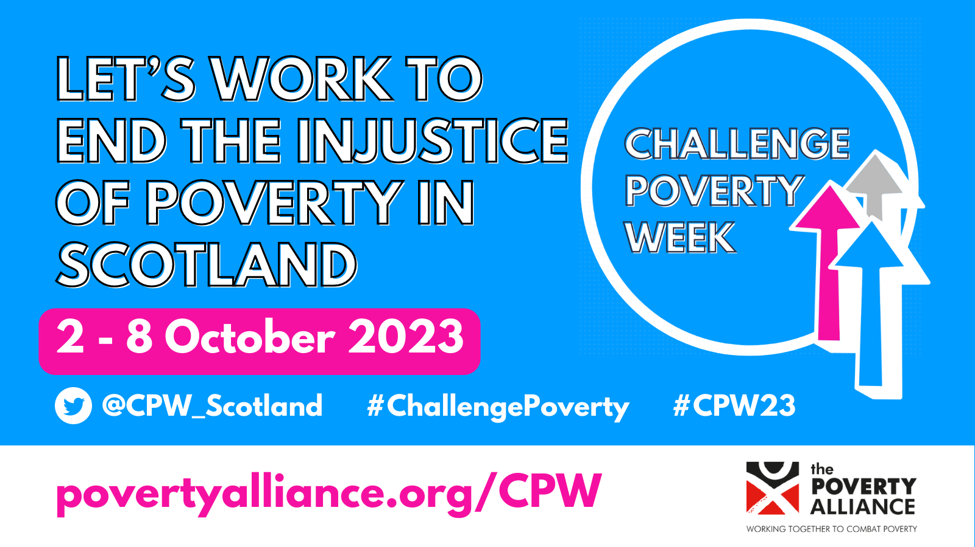

Slide 3
What does the UK public think about poverty?
• More than 20,000 people from across the UK included in the research
• Three clear popular limiting beliefs emerged
• But people also hold helpful views and values we can tap into
• Tested different ways of framing poverty
Notes:
JRF worked with Frameworks in 2019. Poverty Alliance looked at its communications and started to reframe them along the recommendations. We also started training others in how to use the framing, as part of Challenge Poverty Week.

Slide 4
Three popular limiting beliefs
1. “We’re beyond poverty.”
UK society is prosperous and people no longer live in poverty here. Poverty simply doesn’t exist.

Slide 5
Three popular limiting beliefs
2. “|t’s their own fault.”
An individual’s situation is the sole result of their motivation and life choices.

Slide 6
Three popular limiting beliefs
3. “The system is rigged.”
We’re all at the mercy of elites who manipulate the system to keep others down for their own gain.
It’s not worth trying to change things, because nothing ever changes.

Slide 7
How do we change the conversation?

Slide 8
The public also have helpful beliefs we can activate
• We all need clothes, food and somewhere warm to live
• People in poverty have fewer resources and opportunities - once you’re there it’s harder to escape
• The government should take care of our basic needs
• Money gives you choice and freedom

Slide 9
Framing
Framing means making deliberate and effective choices about how you communicate.
“We’re not trying to say what’s popular, we’re trying to make popular what needs to be said.”

Slide 10
Changing attitudes?
70% agreed that there is very real poverty in Scotland
62% said further cutting social security would damage too many people’s lives
Annual social attitudes survey found that pre-lockdown support for social security system was at a 20-year high.

Slide 11
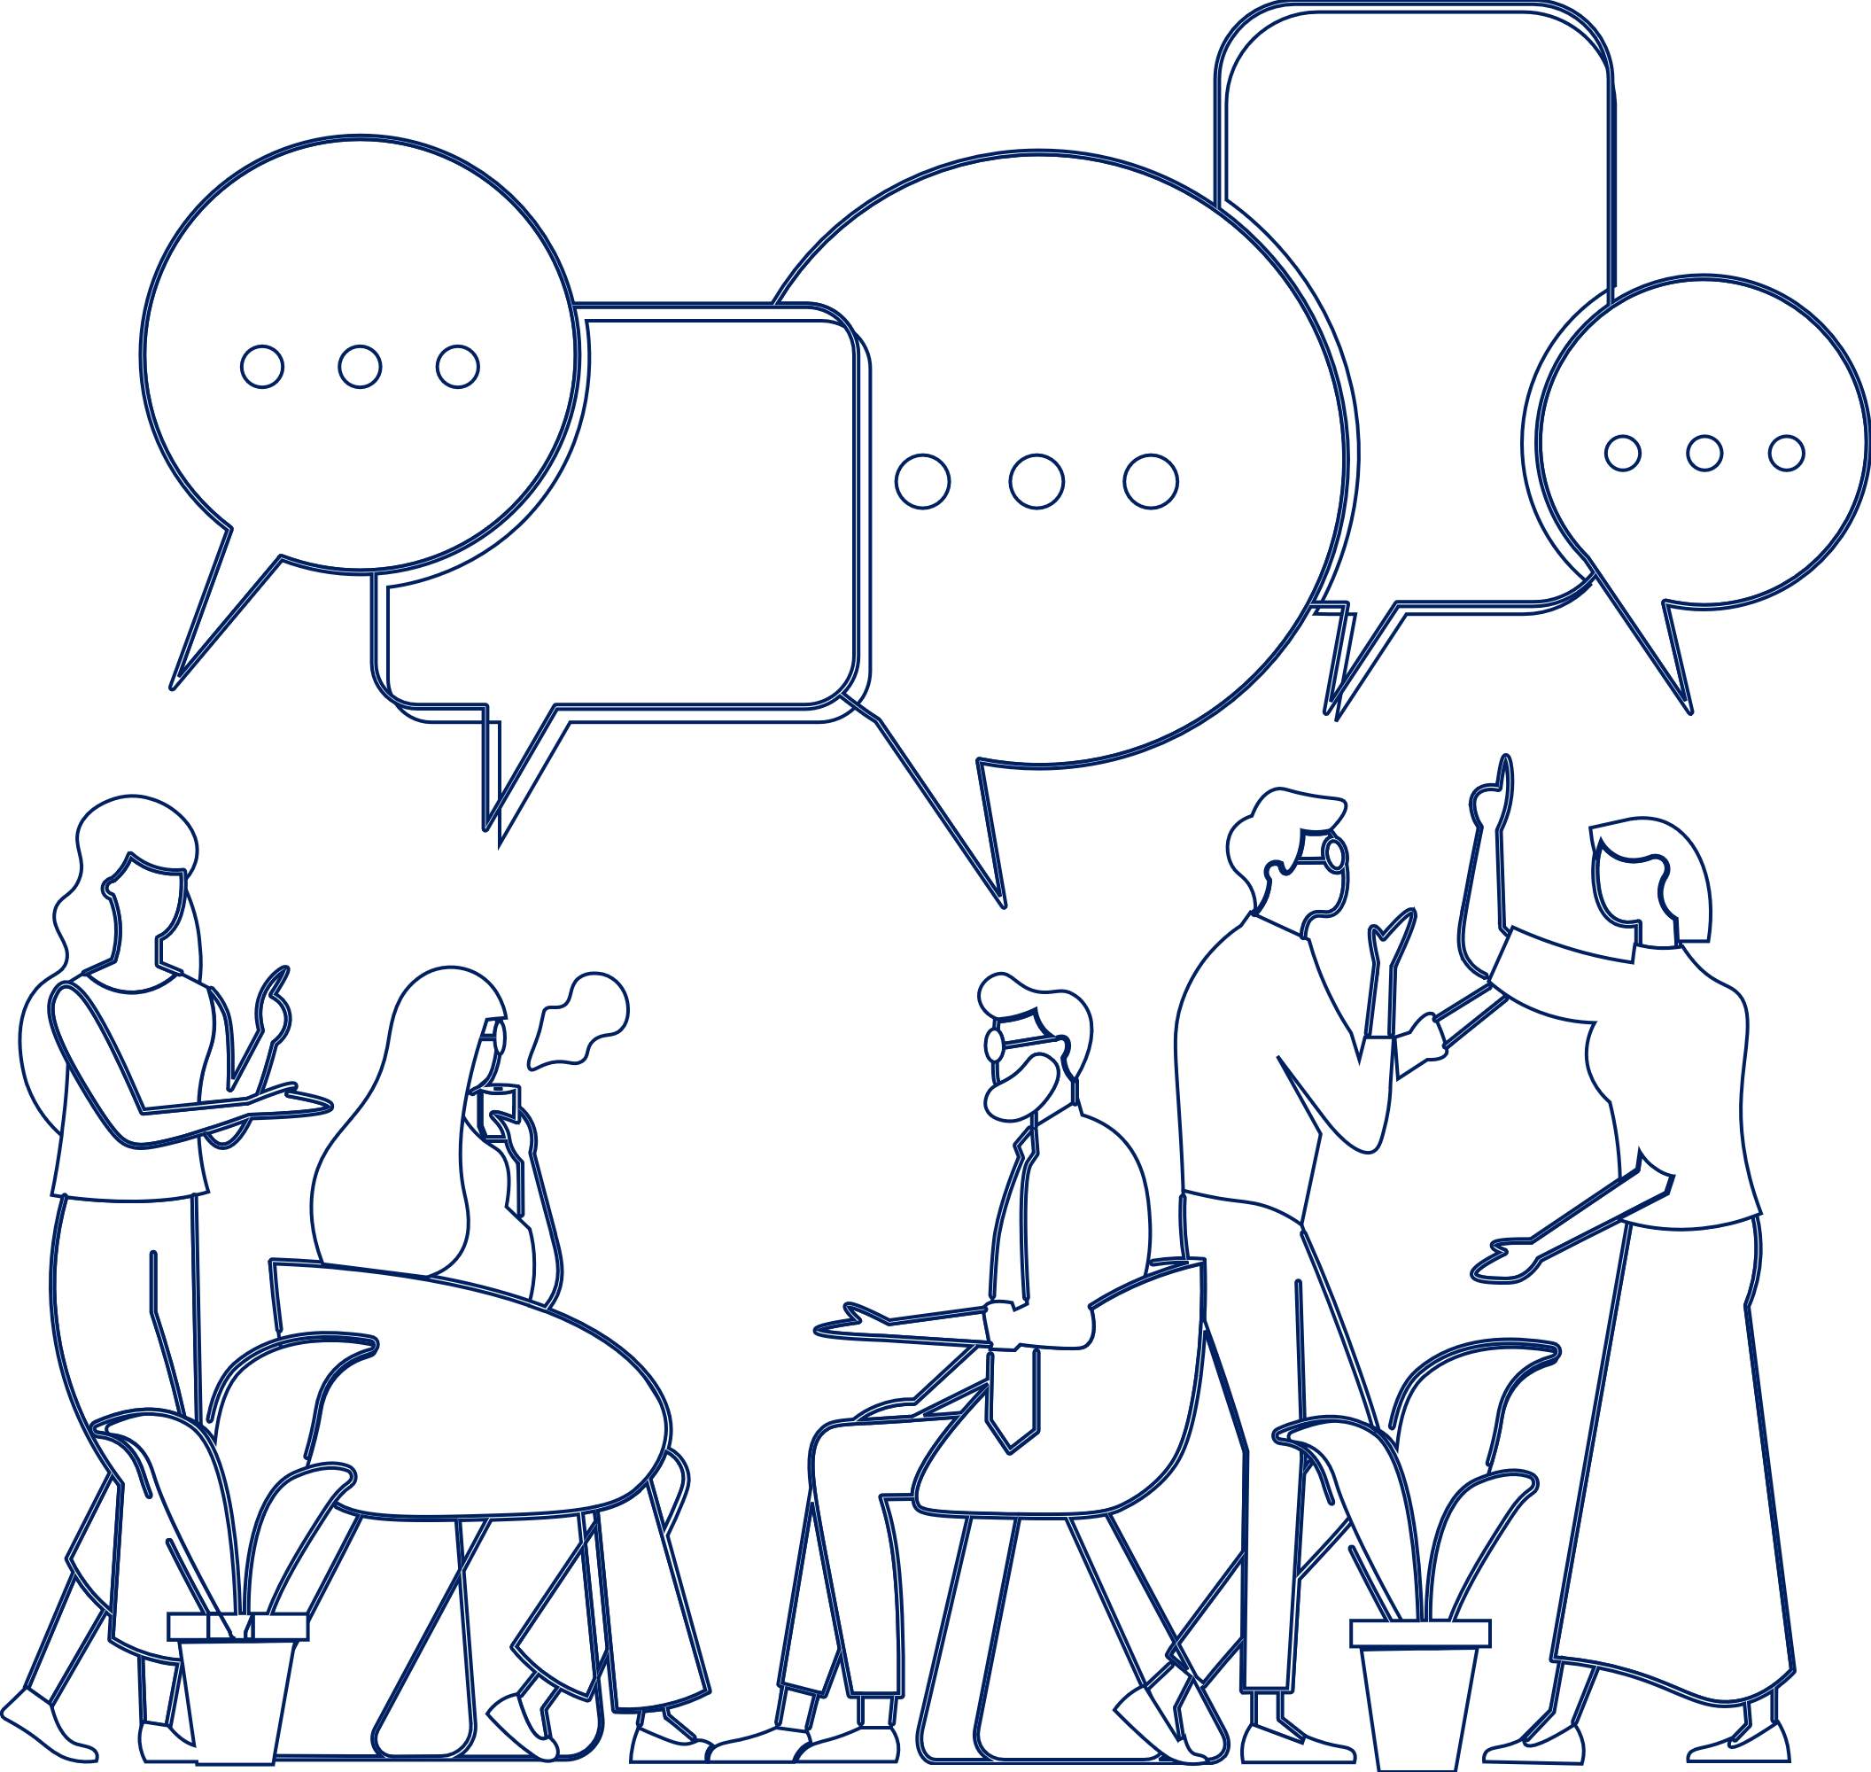
10 ways to talk about poverty.

Slide 12
Make it about values
1
Making a moral case for tackling poverty is the most effective way of framing this issue for a broad audience.
Compassion and justice are particularly effective values to reference.

Slide 13
Activate values. They…
…are widely shared and cherished ideals that show your audience why your issue matters to them
…prime people to think differently
…establish a truth it’s hard to argue with
…create shared grounds for action

Slide 14
No values looks like
“In Scotland, X00,000 people are struggling to get by on Universal Credit and are living in poverty”

Slide 15
With values looks like
“In Scotland, we believe in justice and compassion. But, right now, far too many people in our country are living in poverty. We share a moral responsibility to make sure that everyone has the same chances in life, and can live with dignity.”

Slide 16
Use metaphor
“The economy boxes you in, so you don’t have the same freedom and choices”
“People are being swept up in the rising tide of poverty“
“We can turn the tide of poverty by…”
“Too many of us are struggling to keep our heads above water.”
2

Slide 17
Choose the right messenger
3
Notes:
Also mention the research finding faith leaders and Conservative politicians as good messengers

Slide 18
Choose the right messenger
3
https://www.youtube.com/watch?v=Bv_FqRzFyXo
Notes:
Brighid and Paddy asking people to vote for equal marriage in Irish referendum

Slide 19
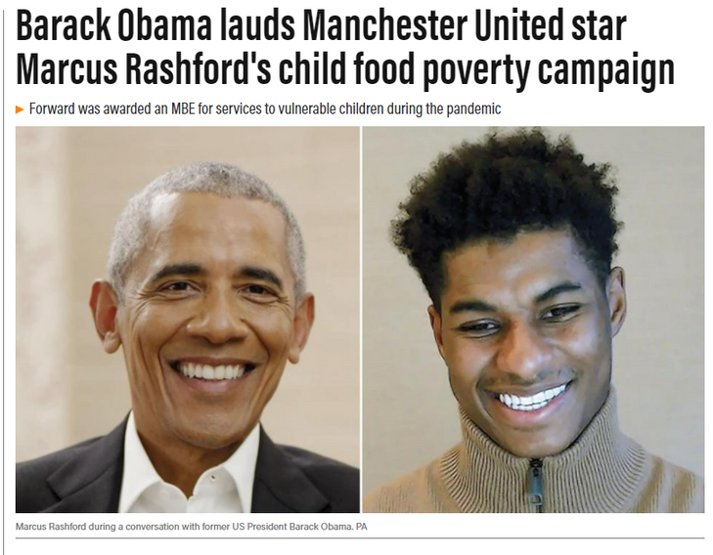
Choose the right messenger

Slide 20
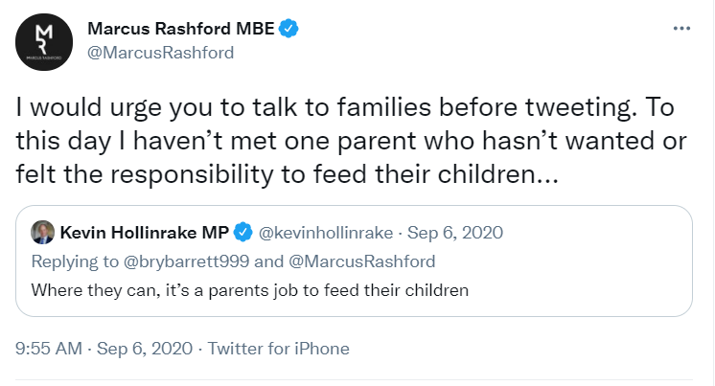
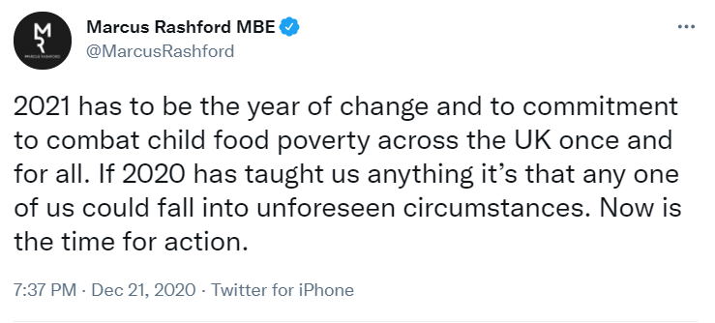
Marcus Rashford
Notes:
Why was Marcus so effective? Lots of values. Lots of ‘us’, ‘we’ and ‘our’.

Slide 21
Lead with poverty
The big problem is poverty – put it up front in messages, before we talk about causes or solutions.
Watch out for leading with benefits or other solutions!
4

Slide 22
Solutions
5
Values first
Outline the issue of poverty
Then solutions!
Balance “we need to do this” with “we can do this”

Slide 23
Stop mythbusting and relying on facts
Use values to frame facts and statistics on the experience of poverty
6

Slide 24
Don’t think of an elephant…
Notes:
When we try to myth-bust, we often end up using the language of our opponents. ‘People on social security aren’t scroungers….’ ‘Union member…’ Using their frames reinforces them in the minds of the audience.

Slide 25
Show how we can redesign
our economy
Real Living Wages
Free childcare
Free public transport
Minimum income guarantees
Repair our social security safety net
Rent controls
7
Notes:
We’re not short of ideas. We just need to convince people that society is unjust without them.

Slide 26
Remind people that public services are a force for good which we all rely on day to day
8
Link social security to education, roads, the NHS.
Notes:
These kinds of universal services help undermine the ‘othering’ and stigma of claimng your social security entitlement. We all pay into the system and it’s there for all of us when we need it. Government spending is there for empowerment and freedom.

Slide 27
When telling people’s stories, be sure to convey the bigger picture
9
Show how the economy and political choices have locked people in poverty and low incomes.
Show the structural, ‘big-picture’ solutions.

Slide 28
Show the lived experience of poverty
10
Demonstrate the lived experience of poverty rather than focusing on its prevalence.
Notes:
Data that shows the rise of foodbank use or housing insecurity is more persuasive than data showing poverty levels – but it must be tied to wider poverty narrative.

Slide 29
Developing your messages
Shared value
Image or metaphor
Solution you want and by who
The problem and its impact

Slide 30
Shared value: “People in Scotland believe in justice and compassion.”
Shared value
The problem and its impact: “But right now, too many people are trapped in the grip of poverty.”
Image or metaphor
Solution you want
and by who
The problem and
its impact
The solution you want from who: “The Scottish Government can free people from unjust poverty, by doubling the Scottish Child Payment.”

Slide 31
“Values are so important. They often give you the ‘why’ of why you do what you do.”

Slide 32
Thank you!
www.povertyalliance.org/valuesfirst
www.povertyalliance.org/cpw
david.eyre@povertyalliance.org
Communications Officer, Poverty Alliance
Notes:
These kinds of universal services help undermine the ‘othering’ and stigma of claimng your social security entitlement. We all pay into the system and it’s there for all of us when we need it. Government spending is there for empowerment and freedom.

